Slide 1
205, Feb 26, Class 23
Final project proposals
Field Research, Cunningham (1989)

Slide 2
Field experiment
Cunningham (1989) trained several colleges students to approach opposite-sex bar patrons at random, delivering one of several different kinds of conversation-starters (“lines”). The positivity of each patron’s response to the line was surreptitiously measured.
Cunningham discovered that women were much more sensitive to the kind of line an opposite-sex person delivered than were men. Women responded more positively too lines that were either self-disclosing or ordinary, like a simple “Hi,” than they did to a flippantly delivered line such as “You remind me of someone I used to date” or “Bet I can outdrink you.”
Men, however, did not appear to care which kind of conversational gambit a woman used; they responded equally positively to all three.

Slide 3
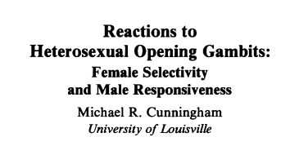
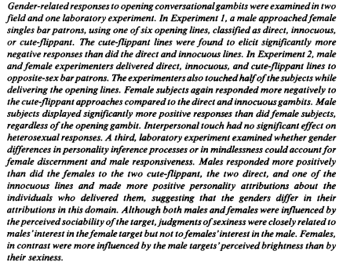


Slide 4
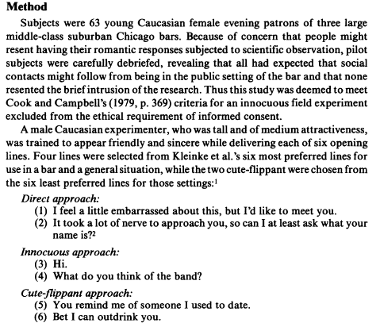
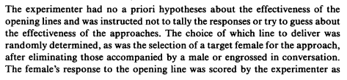
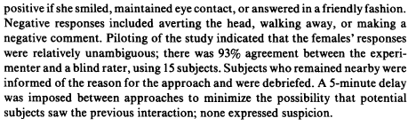
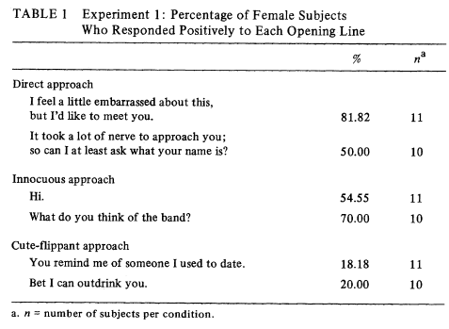

Slide 5
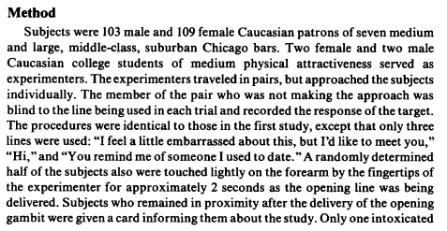
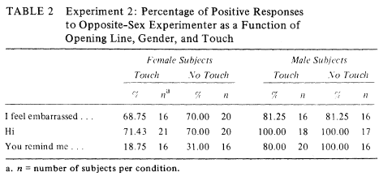

Slide 6
Field Research Procedures
Q1. The experimental report does not include information about the time of day when the data were collected for Experiments 1 or 2. One might imagine that responses to the “lines” might be different at 9pm and 1am.
Give 2 other extraneous variables that might affect the DV for these studies that should be considered in planning data collection.
Q2. How many participants total were run combined across Experiments 1 and 2? How many days/hours/trips to the bars do you think this would have taken?

Slide 7
Internal/External Validity
Q3. Experiment 3 provides a comparable procedure suitable for a well-controlled laboratory environment. How does this improve the internal validity of the results?
Q4. In what ways are Experiment 3 less effective than the field research with respect to external validity of the results?

Slide 8
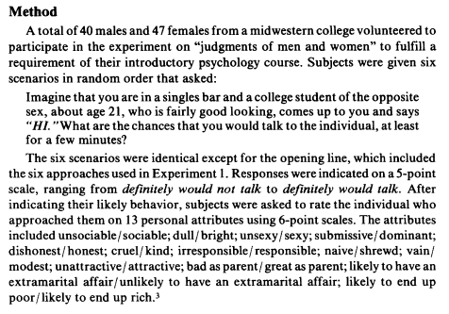
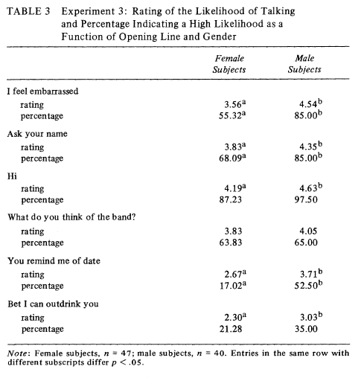

Slide 9
Q5. Experiment 1 includes the note:
“Because of concern that people might resent having their romantic responses subjected to scientific observation, pilot subjects were carefully debriefed, revealing that all had expected that social contacts might follow from being in the public setting of the bar and that non resenting the brief intrusion of the research. Thus this study was deemed to meet Cook and Campbell’s (1979, p. 369) criteria for an innocuous field experiment excluded from the ethical requirement of informed consent.”
This rational does not meet modern expectations for best practices for ethical research.
If one were to propose some similar research today, what ethical issues would you expect the IRB to raise and how might a researcher address those?

Slide 10
Field Research Summary
Quasi-experimental design
Manipulated independent variable
Done outside controlled laboratory conditions
Good external validity
Pretty good internal validity
Procedurally difficult to carry out
Many uncontrolled extraneous variables
Challenging to follow best practices for ethical research
Lack of voluntary participation, informed consent
Implicit deception

Slide 11
Laptops in the classroom
Evidence against
Distraction caused by multitasking (Sana et al. 2013)
Writing is better (Mueller & Oppenheimer, 2014)
Methodological challenges
Grades are a problematic DV
Too many extraneous variables to control
External validity
Differences in students, teachers, material
Changes over time due to greater experience with technology?

Slide 12
Contrasts
T1: A1 > B1
Strongest evidence if successful
Cohort A is better at task performance because of training intervention
Weakest for statistical power
“Between-participants” design vulnerable to individual differences, variability due to measurement error
T2: B2 > B1
Strongest statistical power
Each student is their own control
Inference that intervention caused improvement is weakened by other possible sources of learning between assessments
T3: A1 = A2
Demonstrates retention
Weak statistical test relies on no difference but still useful to document

Slide 13
Brain Training
Jaeggi et al. (2008) reported an intervention that appeared to increase fluid intelligence
Basic science: fluid intelligence is supposed to be immutable
Some core cognitive abilities are traits
Unaffected by education, experience, environment
Applied science: “use it or lose it” in cognitive aging
Lifetime cognitive engagement predicts better aging
High levels of education, “occupational complexity”

Slide 14
Methodological challenges
What is the best control condition to the intervention?
Demand characteristics matter
What is the appropriate dependent variable?
Matrix-based IQ tests are not designed for this
Generalization across age
Undergraduates
Children
Older adults
Effect size estimates
0.8 -> 0.2

Slide 15
RCR Problems
Lumosity Brain Training company
Licensed tasks
Funded efficacy research
Paid a large fine for misleading advertising
Brain training markets
Children with learning disabilities
Older adults and cognitive decline
Conflict of Interest concerns greatly heightened skepticism

Slide 16
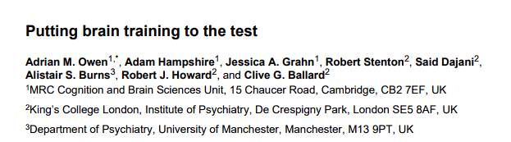
Owen et al. (2010)
Large-scale study failed to find effects
6 weeks of training
N = 11,430 online participants
Practice improved performance on trained tasks
Did not transfer to any general or untrained measures
Similar to many other training studies with null findings

Slide 17
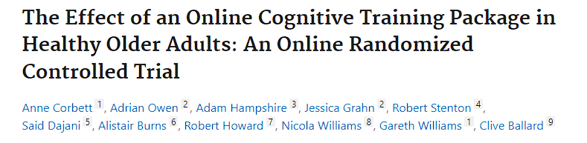
Corbett et al. (2015)
Adults > 60
N = 2912
Reasoning based cognitive training improved performance on reasoning, working memory and verbal learning
Effect size 0.15 – 0.20 for ADL, VL
Effect size 0.30 for Reasoning tasks

Slide 18
Childhood Developmental Studies
More mixed results and RCR issues
“Fast ForWord” result unable to be replicated, but still sold popularly
Auditory training of phonemes to improve reading
Interventions with LD children appear effective
Difficult to control maturation effects
Cognitive functions being trained improve with age, education
Smaller n’s in most studies

Slide 19
Brain Training Summary
Does “brain training” work?
Who’s asking?
Yes, for some populations and some outcomes
Illustrates many challenges of intervention research
What is the intended population and how are they sampled?
What is the dependent variable outcome measure?
How is the control task implemented?
How rigorous is the methodology?

Slide 20
For Wed Feb 28
Chapter 20: Developmental and Neuropsychological Methods
Final project full proposal drafts
As soon as possible

